Slide 1

STATISTICAL AND MATHEMATICAL FOUNDATIONS
Setting The Stage
data-action-lab.com

Slide 2
OUTLINE
Modeling
Distributions
Central Limit Theorem
Estimation
Bayes’ Theorem
Matrix Algebra
Eigenvalues and Eigenvectors
Regression
Optimization

Slide 3


[http://dailycatdrawings.tumblr.com; #309]
Real World
Model
Theory
Identification of details relevant to description and translation of real-world objects into model variables

Slide 4
Models in General
First principles modeling
examine a system
write down a set of rules/equations that describe the essence of the system
ignore complicating details that are “less” important
Statistical modeling
typically a set of equations with parameters
parameters are learned (model is “trained”) using multiple data observations
data sample vs. population

Slide 5
Modeling HEURISTICS
Basic steps in building a statistical model:
defining the goals
gathering data
deciding on the model structure
preparing the data
selecting and removing features
building candidate models
finalizing the model
implementing and monitoring

Slide 6
Data and Distributions
If a data feature can be characterized by a distribution, consider asking four basic questions:
Can the variable only take on discrete values? continuous values?
Is the data distribution symmetric?
Does the variable have theoretical upper and lower limits?
How likely is it to observe extreme values in the distribution?

Slide 7
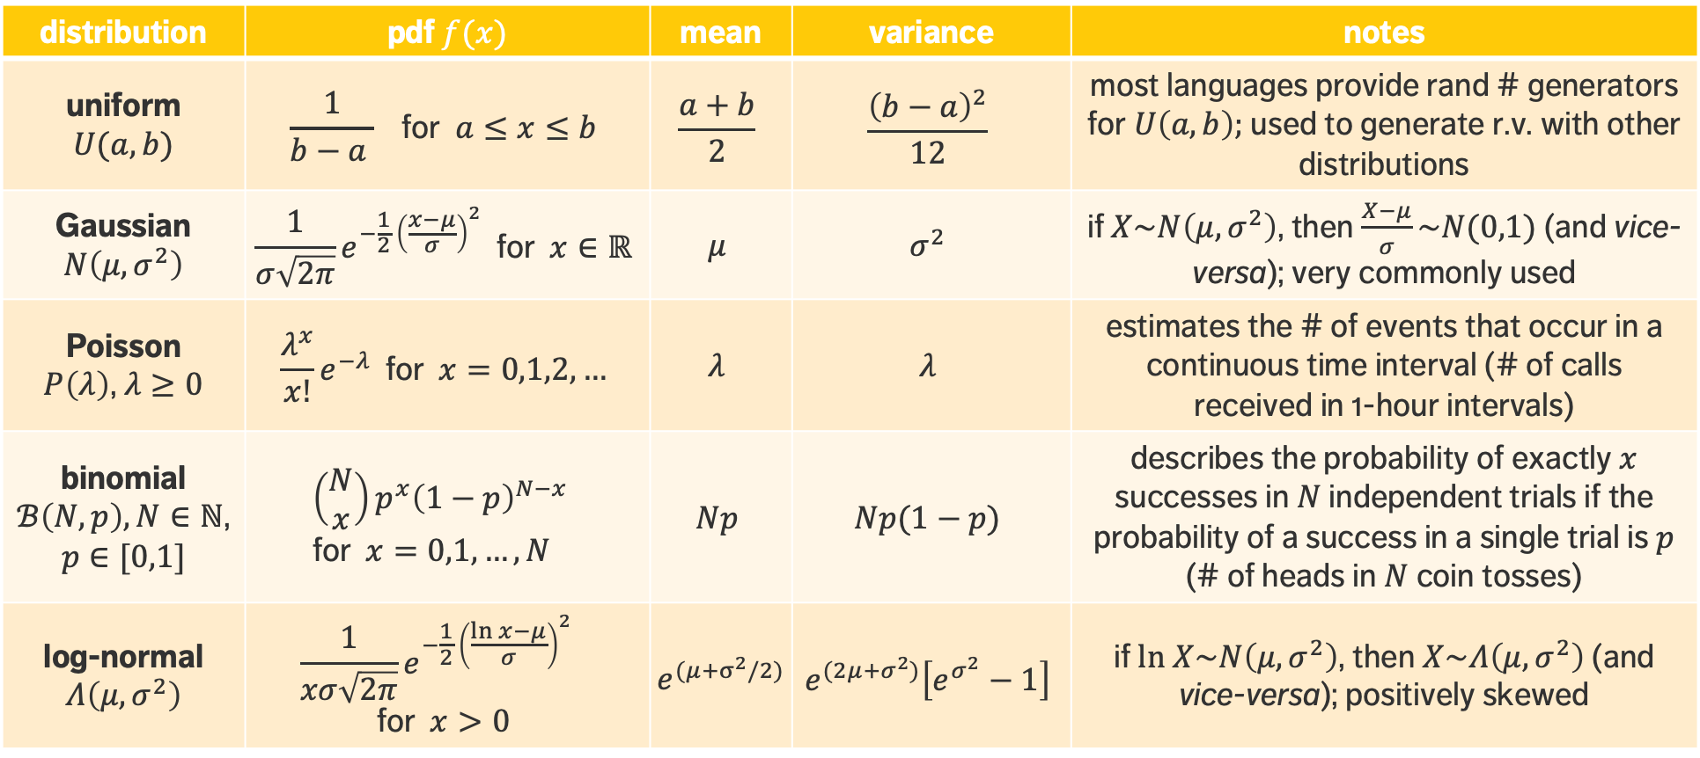
distribution | pdf $f(x)$ | mean | variance | notes
uniform $U(a,b)$ | $$\frac{1}{b−a } \text{for} a≤x≤b$$ | $$\frac{a+b}{2}$$ | $$\frac{{\left(b−a\right)}^{2}}{12}$$ | most languages provide rand # generators for $U\left(a,b\right);$ used to generate r.v. with other distributions
Gaussian $N\left(μ,σ^{2}\right)$ | $$\frac{1}{σ\sqrt{2π}}e^{−\frac{1}{2} {\left(\frac{x−μ}{σ}\right)}^{2}} \text{for} x∈ℝ$$ | $$μ$$ | $$σ^{2}$$ | if $X\sim N\left(μ,σ^{2}\right)$, then $\frac{X−μ}{σ}\sim N(0,1)$ (and vice-versa); very commonly used
Poisson $P\left(λ\right)$, $λ≥0$ | $$\frac{λ^{x}}{x!}ⅇ^{−λ} \text{for} x=0,1,2,…$$ | $$λ$$ | $$λ$$ | estimates the # of events that occur in a continuous time interval (# of calls received in 1-hour intervals)
binomial $ℬ\left(N,p\right),N∈ℕ$, $p∈[0,1]$ | $$\left(\begin{matrix}N \\ x\end{matrix}\right)p^{x}{\left(1−p\right)}^{N−x} \\ \text{for} x=0,1,…,N$$ | $$Np$$ | $$Np(1−p)$$ | describes the probability of exactly $x$ successes in $N$ independent trials if the probability of a success in a single trial is $p$ (# of heads in $N$ coin tosses)
log-normal $Λ\left(μ,σ^{2}\right)$ | $$\frac{1}{xσ\sqrt{2π}}e^{−\frac{1}{2} {\left(\frac{ln x−μ}{σ}\right)}^{2}} \\ \text{for} x>0$$ | $e^{(μ+σ^{2}/2)}$ | $$e^{(2μ+σ^{2})}\left[e^{σ^{2}}−1\right]$$ | if $ln X\sim N\left(μ,σ^{2}\right)$, then $X\sim Λ\left(μ,σ^{2}\right)$ (and vice-versa); positively skewed

Slide 8
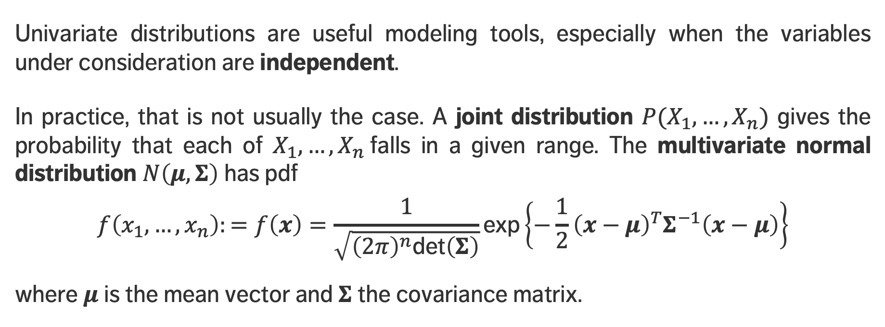
Joint Distributions
Univariate distributions are useful modeling tools, especially when the variables under consideration are independent.
In practice, that is not usually the case. A joint distribution $P(X_{1},…, X_{n})$ gives the probability that each of $X_{1},…, X_{n}$falls in a given range. The multivariate normal distribution $N\left(μ,Σ\right)$ has pdf
$$f\left(x_{1},…, x_{n}\right):=f\left(x\right)=\frac{1}{\sqrt{{\left(2π\right)}^{n}\text{det}\left(Σ\right)}}\text{exp}\left\{−\frac{1}{2}{\left(x−μ\right)}^{T}Σ^{−1}\left(x−μ\right)\right\}$$
where $μ$ is the mean vector and $Σ$ the covariance matrix.

Slide 9
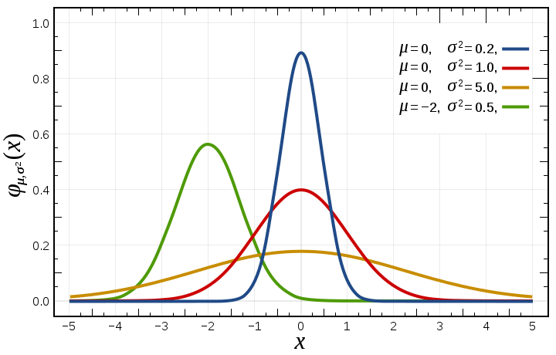

Normal Distribution
[image taken from Wikipedia]
$N\left(μ,σ^{2}\right)$is fully characterized by the mean $μ$and the standard deviation $σ$, which reduces estimation requirements.
The probability of a value being drawn can be obtained if we know how many multiples of $σ$ separate it from $μ$
within $σ$ from $μ$: $≈68\%$
within $2σ$ from $μ$: $≈95\%$
within $3σ$ from $μ$: $≈99.7\%$

Slide 10
Normal Distribution
The normal distribution is best suited for data meeting the following minimum requirements:
strong tendency for the data to take on a central value
positive, negative deviations from this central value are equally likely
frequency of the deviations falls off rapidly as we move further away from the central value.
Symmetry of deviations leads to zero skewness; low prob. of large deviations from the central value leads to no kurtosis.
Its omnipresence in human affairs is linked to the Central Limit Theorem.

Slide 11
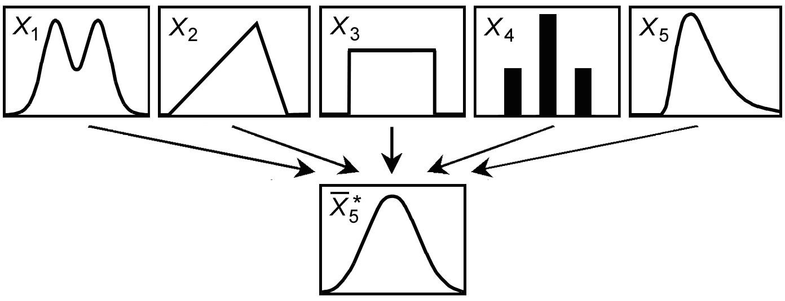
CENTRAL LIMIT THEOREM IN ACTION
[https://www.value-at-risk.net/central-limit-theorem]

Slide 12
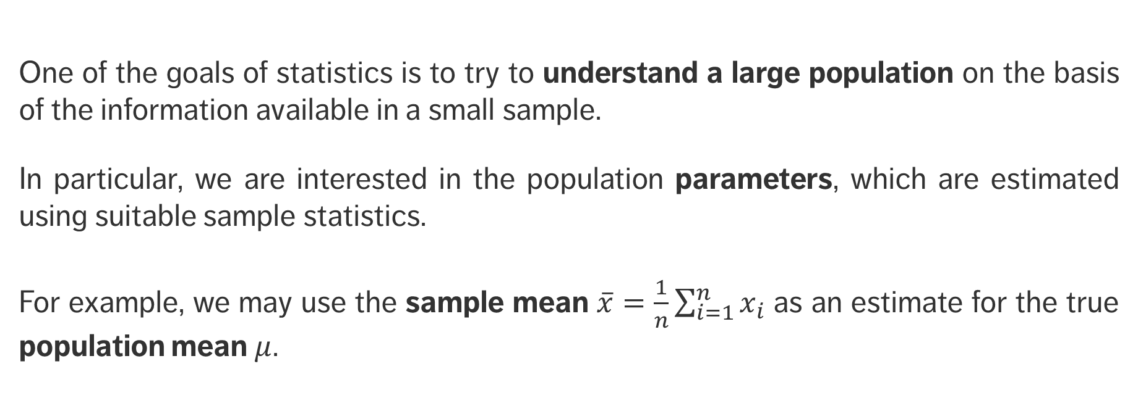
Estimation
One of the goals of statistics is to try to understand a large population on the basis of the information available in a small sample.
In particular, we are interested in the population parameters, which are estimated using suitable sample statistics.
For example, we may use the sample mean $\overline{x}=\frac{1}{n}\sum_{i=1}^{n}{x_{i}}$ as an estimate for the true population mean $μ$.

Slide 13
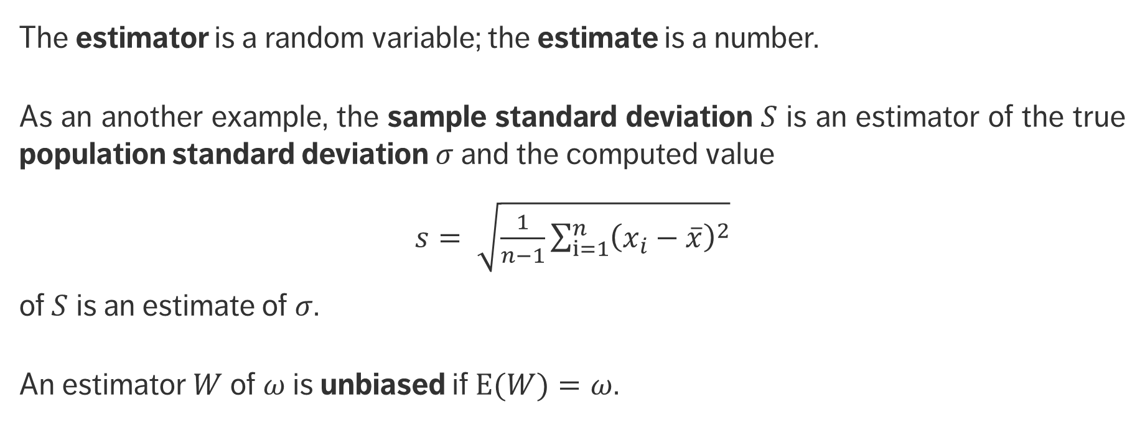
Estimation
The estimator is a random variable; the estimate is a number.
As an another example, the sample standard deviation $S$ is an estimator of the true population standard deviation $σ$ and the computed value
$s= \sqrt{\frac{1}{n−1}\sum_{i=1}^{n}{{\left(x_{i}−\overline{x}\right)}^{2}}}$
of $S$ is an estimate of $σ$.
An estimator $W$ of $ω$ is unbiased if $E(W)=ω$.

Slide 14
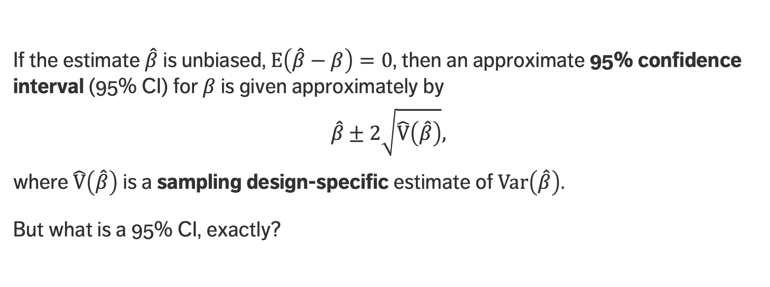
BASIC MATHEMATICAL CONCEPTS
If the estimate $\hat{β}$ is unbiased, $E\left(\hat{β}−β\right)=0$, then an approximate 95% confidence interval (95% CI) for $β$ is given approximately by
$$\hat{β}±2\sqrt{\hat{\text{V}}\left(\hat{β}\right)},$$
where $\hat{\text{V}}\left(\hat{β}\right)$ is a sampling design-specific estimate of $\text{V}\text{ar}\left(\hat{β}\right)$.
But what is a 95% CI, exactly?

Slide 15
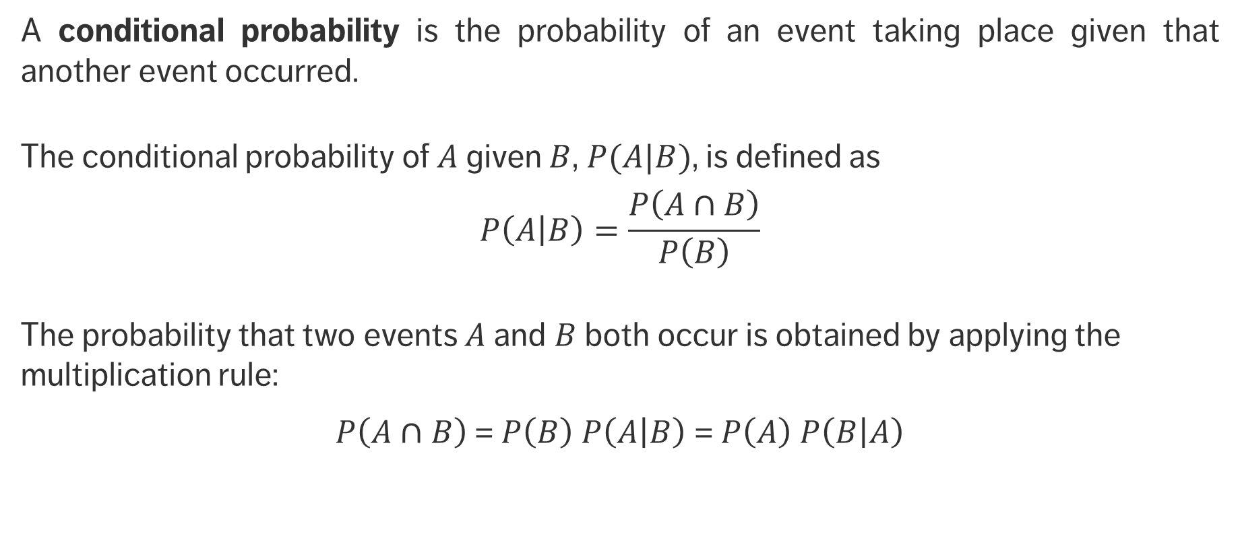
Conditional Probabilities
A conditional probability is the probability of an event taking place given that another event occurred.
The conditional probability of $A$ given $B$, $P(A|B)$, is defined as
$$P\left(\left.A\right|B\right)=\frac{P\left(A∩B\right)}{P\left(B\right)}$$
The probability that two events $A$ and $B$ both occur is obtained by applying the multiplication rule:
$P\left(A∩B\right)$= $P\left(B\right) P\left(\left.A\right|B\right)$ = $P\left(A\right) P\left(\left.B\right|A\right)$

Slide 16
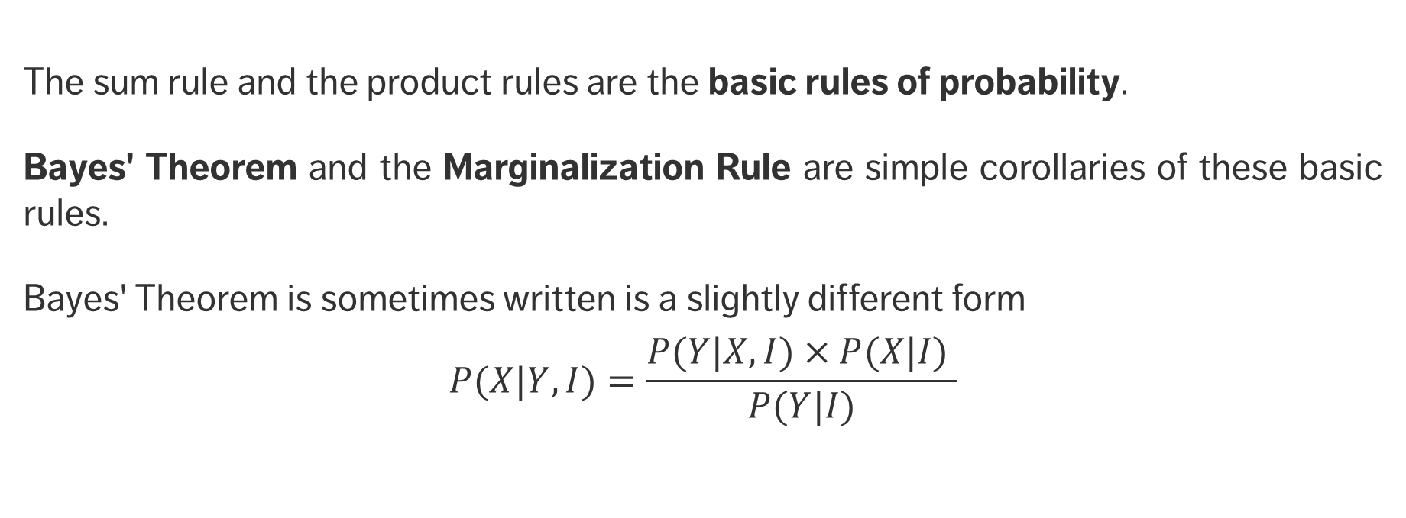
Bayes’ Theorem
The sum rule and the product rules are the basic rules of probability.
Bayes' Theorem and the Marginalization Rule are simple corollaries of these basic rules.
Bayes' Theorem is sometimes written is a slightly different form
$$P(X|Y,I)=\frac{P(Y|X,I)×P(X|I) }{P(Y|I)}$$

Slide 17
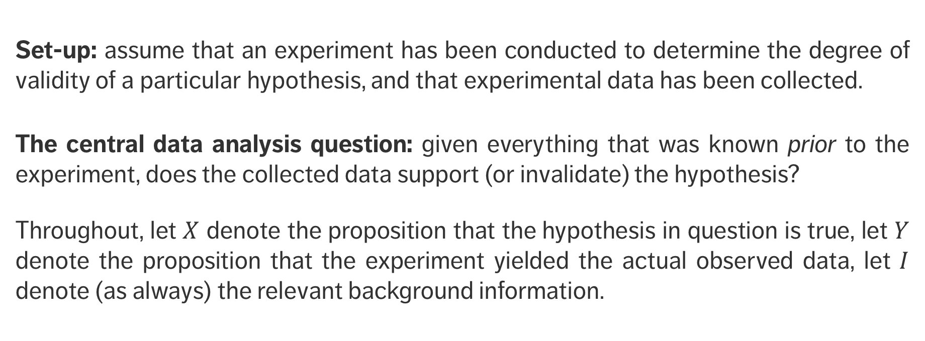
Bayes’ Theorem
Set-up: assume that an experiment has been conducted to determine the degree of validity of a particular hypothesis, and that experimental data has been collected.
The central data analysis question: given everything that was known prior to the experiment, does the collected data support (or invalidate) the hypothesis?
Throughout, let $X$ denote the proposition that the hypothesis in question is true, let $Y$ denote the proposition that the experiment yielded the actual observed data, let $I$ denote (as always) the relevant background information.

Slide 18
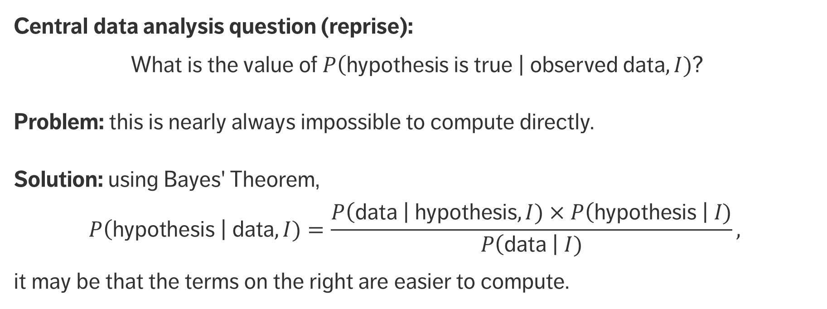
Bayes’ Theorem
Central data analysis question (reprise):
What is the value of $P\left(\text{hypothesis} \text{is} \text{true} \right| \text{observed} \text{data},I)$?
Problem: this is nearly always impossible to compute directly.
Solution: using Bayes' Theorem,
$$P\left(\text{hypothesis} \right| \text{data},I)=\frac{P\left(\text{data} \right| \text{hypothesis},I)×P\left(\text{hypothesis} \right| I)}{P\left(\text{data} \right| I)},$$
it may be that the terms on the right are easier to compute.
likelihood
prior
posterior
evidence

Slide 19
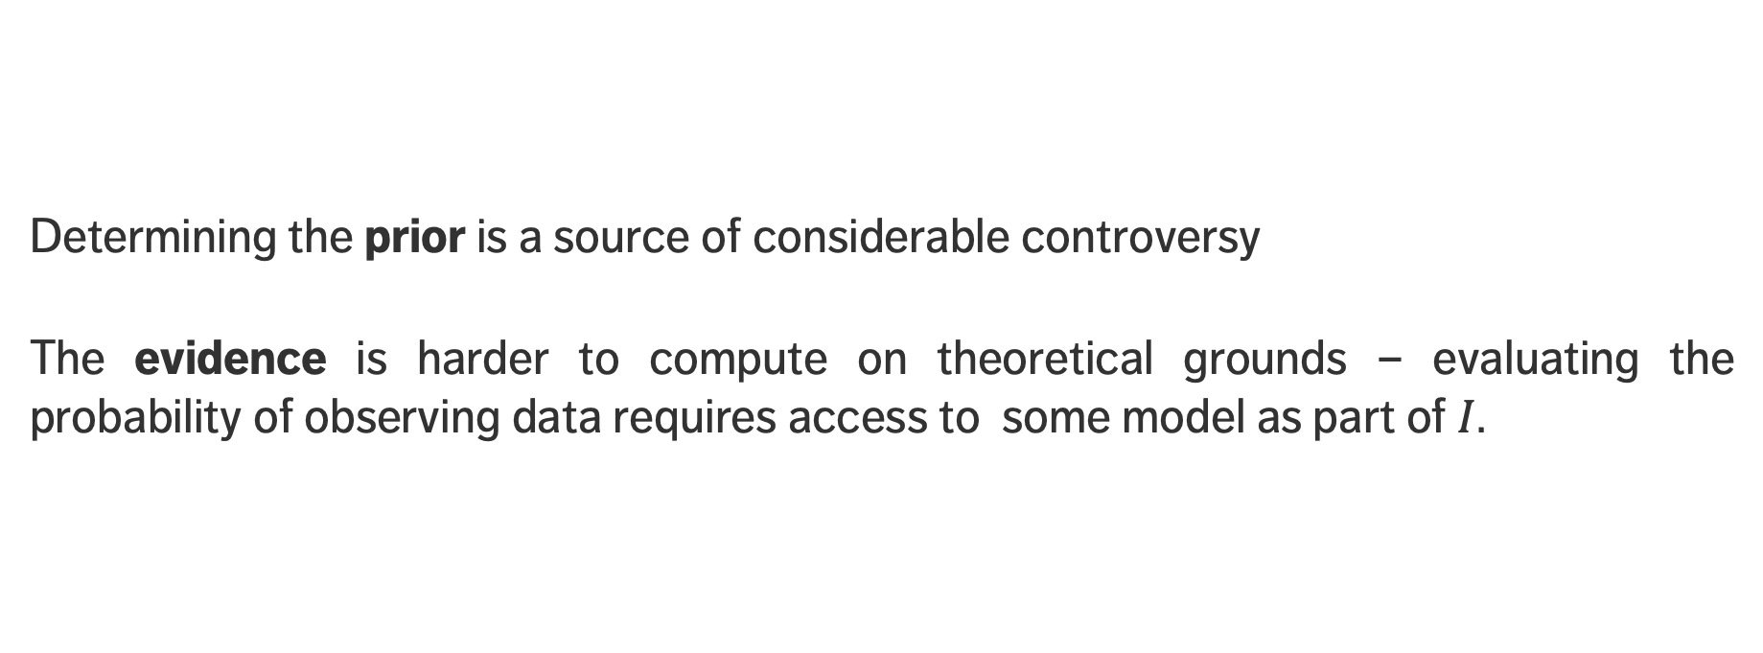
Bayes’ Theorem
Determining the prior is a source of considerable controversy
The evidence is harder to compute on theoretical grounds – evaluating the probability of observing data requires access to some model as part of $I$.

Slide 20
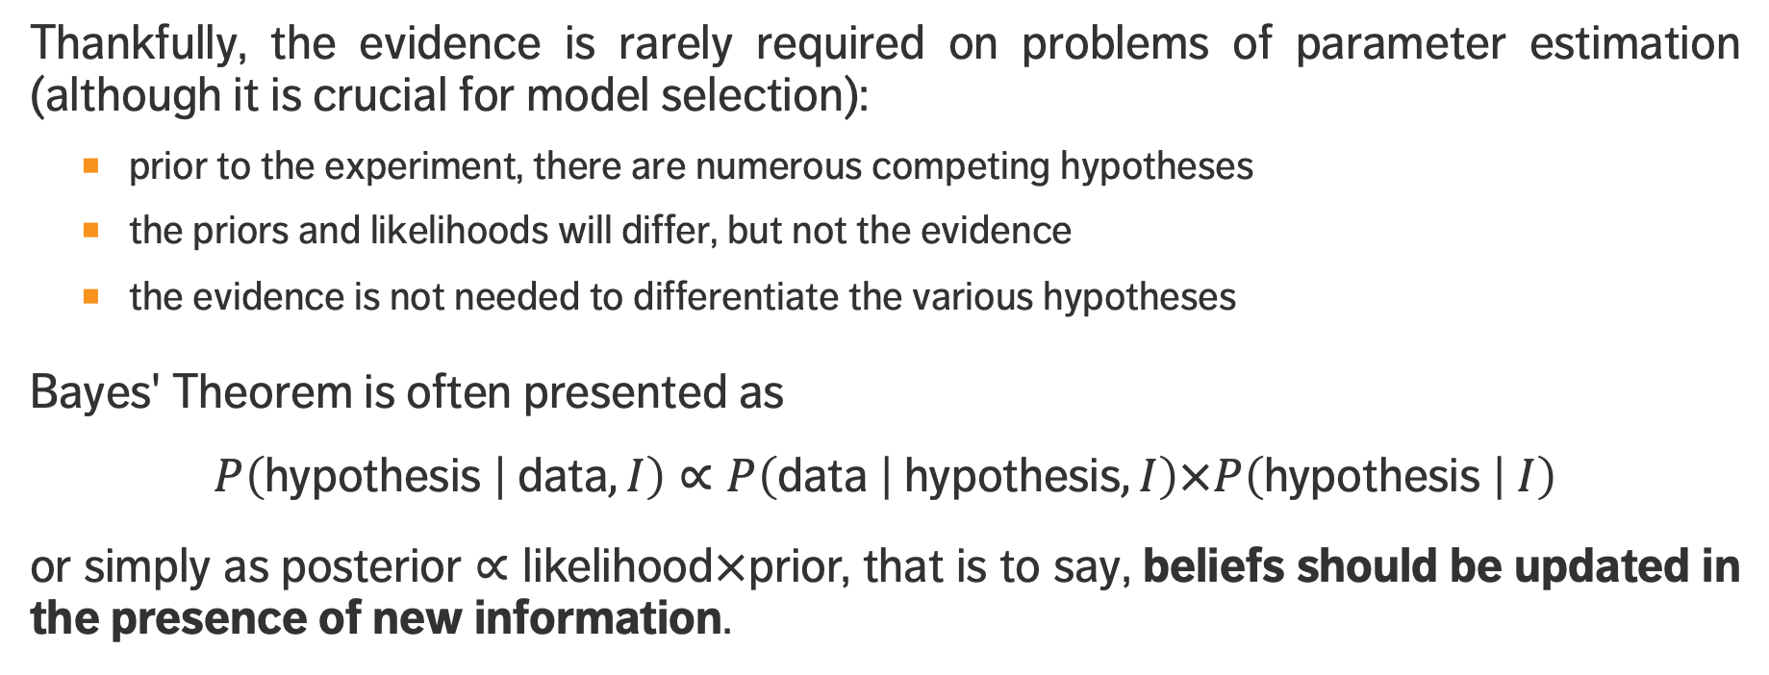
Bayes’ Theorem
Thankfully, the evidence is rarely required on problems of parameter estimation (although it is crucial for model selection):
prior to the experiment, there are numerous competing hypotheses
the priors and likelihoods will differ, but not the evidence
the evidence is not needed to differentiate the various hypotheses
Bayes' Theorem is often presented as
$$P\left(\text{hypothesis} | \text{data},I\right)∝P\left(\text{data} | \text{hypothesis},I\right)×P\left(\text{hypothesis} | I\right)$$
or simply as $\text{posterior}∝\text{likelihood}×\text{prior}\text{,}$ that is to say, beliefs should be updated in the presence of new information.

Slide 21
Linear Algebra
A matrix is an important mathematical tool that allows for easy organization of information, simplifies notation, and facilitates the application of algorithms to data.
Most statistical tools require rectangular data:
each column contains a variable (feature, field, attribute)
- indicator, target, question in a survey, etc.
each row contains an observation (case, unit, item)
- country, survey respondent, subject in an experiment, etc.
each cell contains a value (measurement) for a particular variable and observation
- GDP per capita for Canada, answer to a specific question, age, etc.

Slide 22
Matrix Operations
A matrix is a rectangular grid of elements arranged into rows and columns.
Matrices are often used in algebra to solve for unknown values in linear equations, and in geometry.
You should know how to do
matrix addition, multiplication by a scalar, matrix transposition
matrix multiplication
matrix inversion, matrix determinant, matrix trace

Slide 23
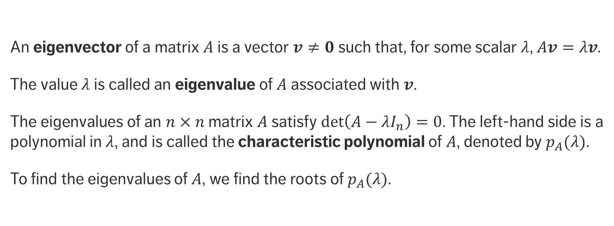
Eigenvectors and Eigenvalues
An eigenvector of a matrix $A$ is a vector $v≠0$ such that, for some scalar $λ$, $Av=λv$.
The value $λ$ is called an eigenvalue of $A$ associated with $v$.
The eigenvalues of an $n×n$ matrix $A$ satisfy $\det\left(A−λI_{n}\right)=0$. The left-hand side is a polynomial in $λ$, and is called the characteristic polynomial of $A$, denoted by $p_{A}(λ)$.
To find the eigenvalues of $A$, we find the roots of $p_{A}(λ)$.

Slide 24
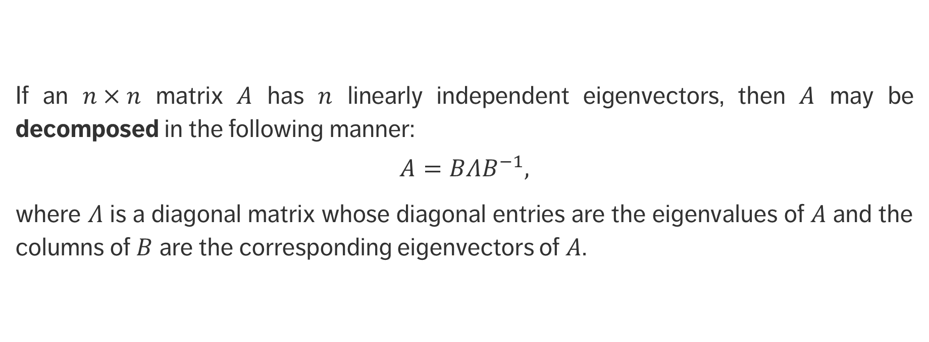
Eigen-decomposition
If an $n×n$ matrix $A$ has $n$ linearly independent eigenvectors, then $A$ may be decomposed in the following manner:
$$A=BΛB^{−1},$$
where $Λ$ is a diagonal matrix whose diagonal entries are the eigenvalues of $A$ and the columns of $B$ are the corresponding eigenvectors of $A$.

Slide 25
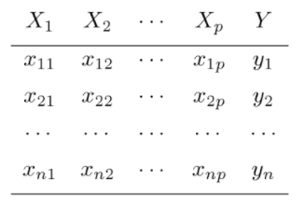
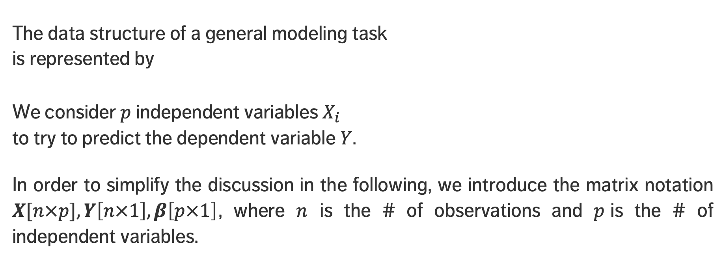
Regression Modeling
The data structure of a general modeling task is represented by
We consider $p$independent variables $X_{i}$ to try to predict the dependent variable $Y$.
In order to simplify the discussion in the following, we introduce the matrix notation $X[n×p], Y\left[n×1\right], β\left[p×1\right]$, where $n$ is the # of observations and $p$is the # of independent variables.

Slide 26
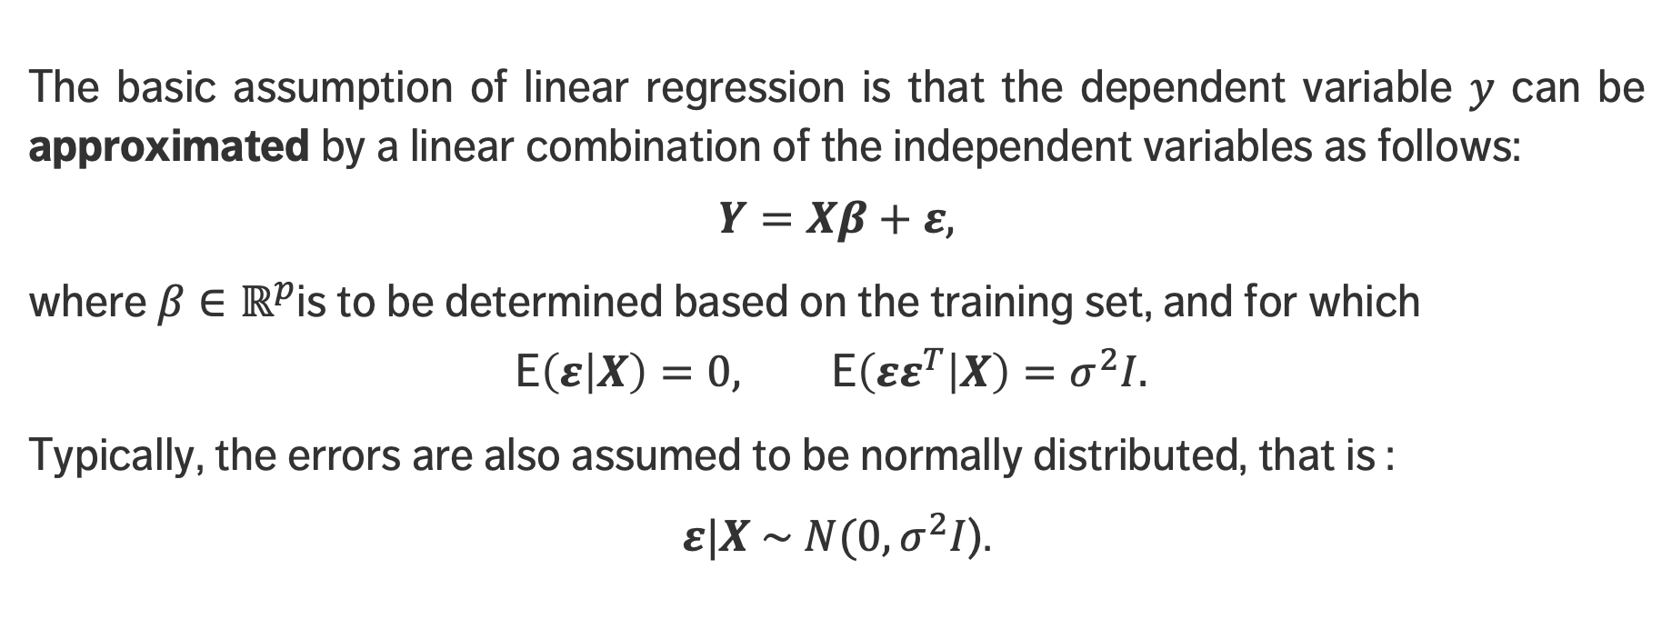
Linear Regression
The basic assumption of linear regression is that the dependent variable $y$ can be approximated by a linear combination of the independent variables as follows:
$$Y=Xβ+ε,$$
where $β∈ℝ^{p}$is to be determined based on the training set, and for which
$$\text{E}\left(ε | X\right)=0, \text{E}\left(εε^{T} | X\right)=σ^{2}I.$$
Typically, the errors are also assumed to be normally distributed, that is :
$ε|X \sim N(0, σ^{2}I$).

Slide 27
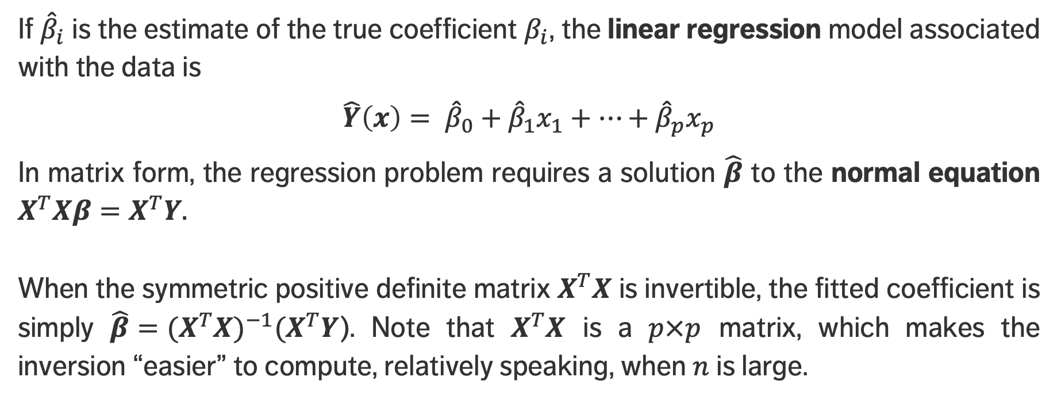
Linear Regression
If ${\hat{β}}_{i}$ is the estimate of the true coefficient $β_{i}$, the linear regression model associated with the data is
$$\hat{Y}\left(x\right)= {\hat{β}}_{0}+{\hat{β}}_{1}x_{1}+⋯+{\hat{β}}_{p}x_{p}$$
In matrix form, the regression problem requires a solution $\hat{β}$ to the normal equation $X^{T}Xβ=X^{T}Y.$
When the symmetric positive definite matrix $X^{T}X$ is invertible, the fitted coefficient is simply ${{\hat{β}=(X}^{T}X)}^{−1}{(X}^{T}Y$). Note that $X^{T}X$ is a $p×p$ matrix, which makes the inversion “easier” to compute, relatively speaking, when $n$ is large.

Slide 28
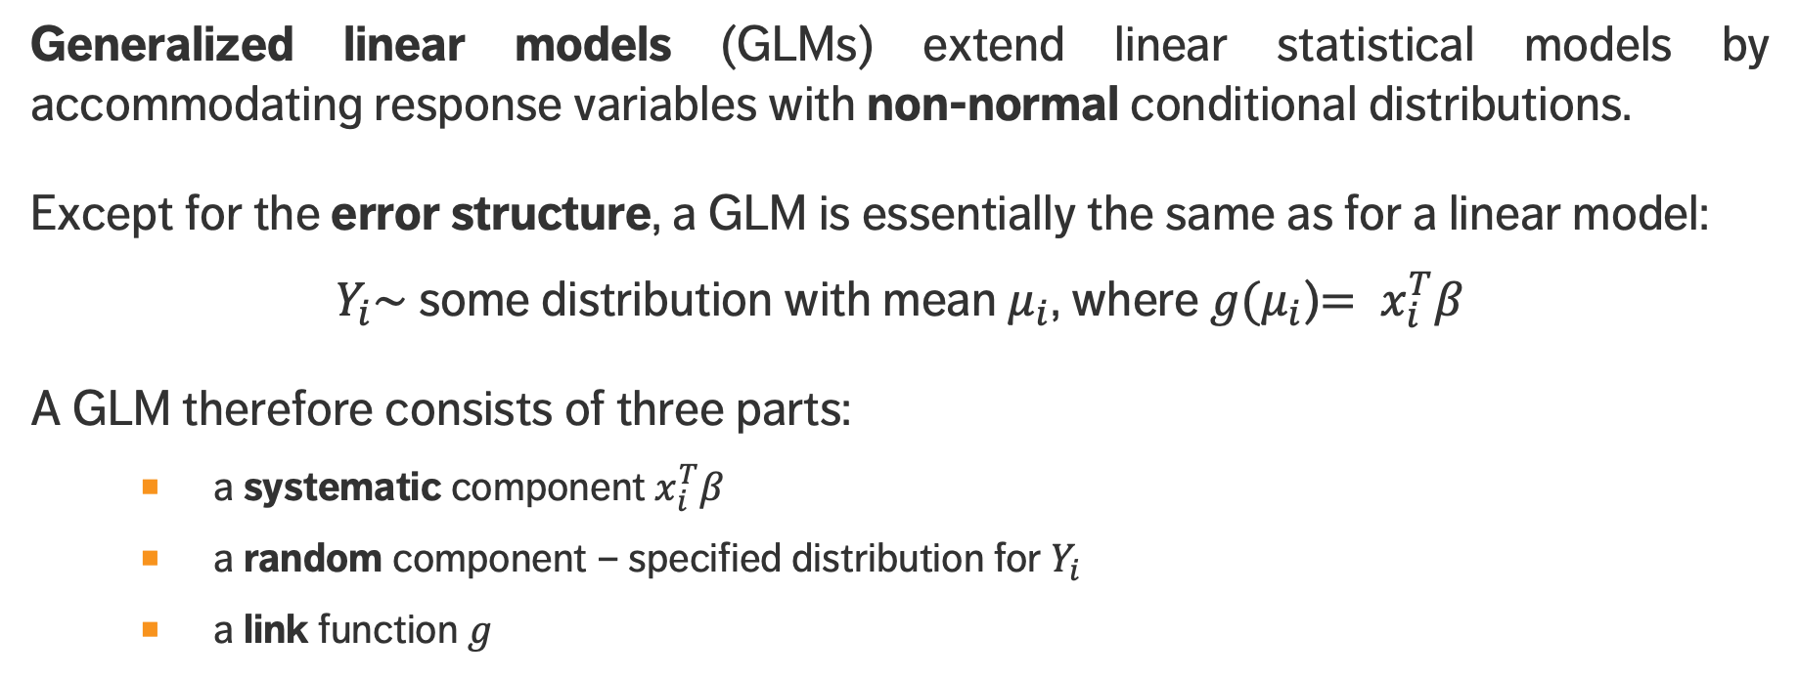
Generalized Linear Regression
Generalized linear models (GLMs) extend linear statistical models by accommodating response variables with non-normal conditional distributions.
Except for the error structure, a GLM is essentially the same as for a linear model:
$Y_{i}\sim$some distribution with mean $μ_{i}$, where$g(μ_{i}$)$= x_{i}^{T}β$
A GLM therefore consists of three parts:
a systematic component $x_{i}^{T}β$
a random component – specified distribution for $Y_{i}$
a link function $g$

Slide 29
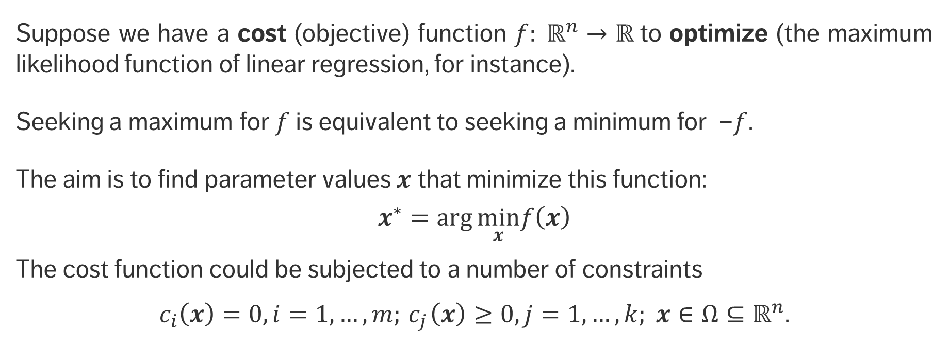
Optimization
Suppose we have a cost (objective) function $f: ℝ^{n}→ℝ$to optimize (the maximum likelihood function of linear regression, for instance).
Seeking a maximum for $f$ is equivalent to seeking a minimum for –$f$.
The aim is to find parameter values $x$ that minimize this function:
$$x^{∗}=\arg{\min_{x}f\left(x\right)}$$
The cost function could be subjected to a number of constraints
$c_{i}\left(x\right)=0, i=1,…,m;{ c}_{j}\left(x\right)≥0, j=1,…,k; x∈Ω⊆ℝ^{n}$.

Slide 30
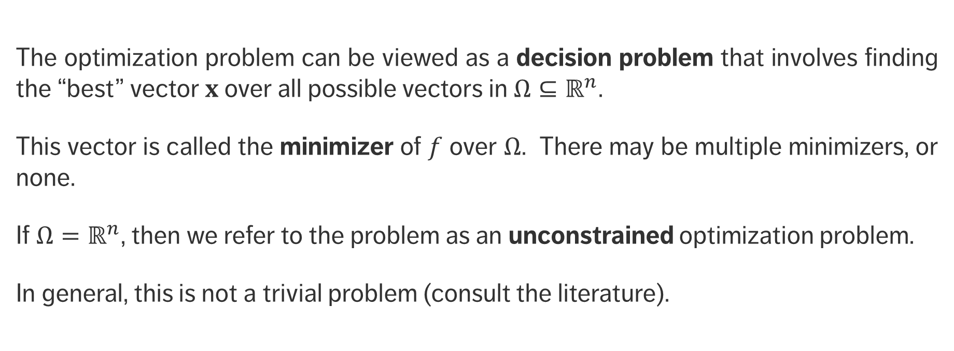
Optimization
The optimization problem can be viewed as a decision problem that involves finding the “best” vector $x$ over all possible vectors in $Ω{⊆ℝ}^{n}$.
This vector is called the minimizer of $f$ over $Ω$. There may be multiple minimizers, or none.
If $Ω{=ℝ}^{n}$, then we refer to the problem as an unconstrained optimization problem.
In general, this is not a trivial problem (consult the literature).

Slide 31
Type of Minima
local minima
In many instances, optimization is a numerical endeavour. Which of the minima is found depends on the algorithm‘s starting point.
global minimum
feasibility region

